Slide 1
IMPLEMENTATION AND MAINTENANCE OF THE WATER RECONCILIATION STRATEGY FOR RICHARDS BAY AND SURROUNDING TOWNS
Strategy Steering Committee Meeting
(StraSC) 4
Thursday, 25 June 2020

Slide 2
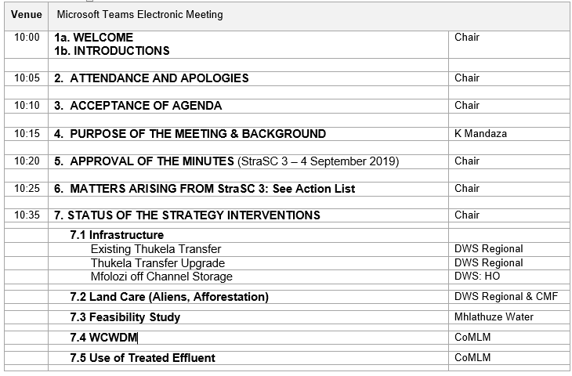
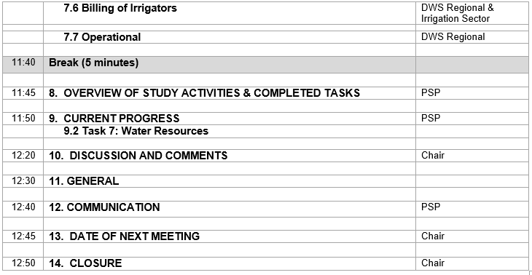
Agenda

Slide 3
IMPLEMENTATION AND MAINTENANCE OF THE WATER RECONCILIATION STRATEGY FOR RICHARDS BAY AND SURROUNDING TOWNS
Strategy Steering Committee Meeting
(StraSC) 4
Item 4: Purpose of the Meeting

Slide 4
ROLE OF THE STRATEGY STEERING COMMITTEE
As members of the StraSC your responsibility is to:
Drive processes assigned to your organization relating to Strategy Interventions
Provide feedback to Committee on progress of Actions
Disseminate information into the relevant departments / organisations
Incorporate strategies’ recommendations into development plans

Slide 5
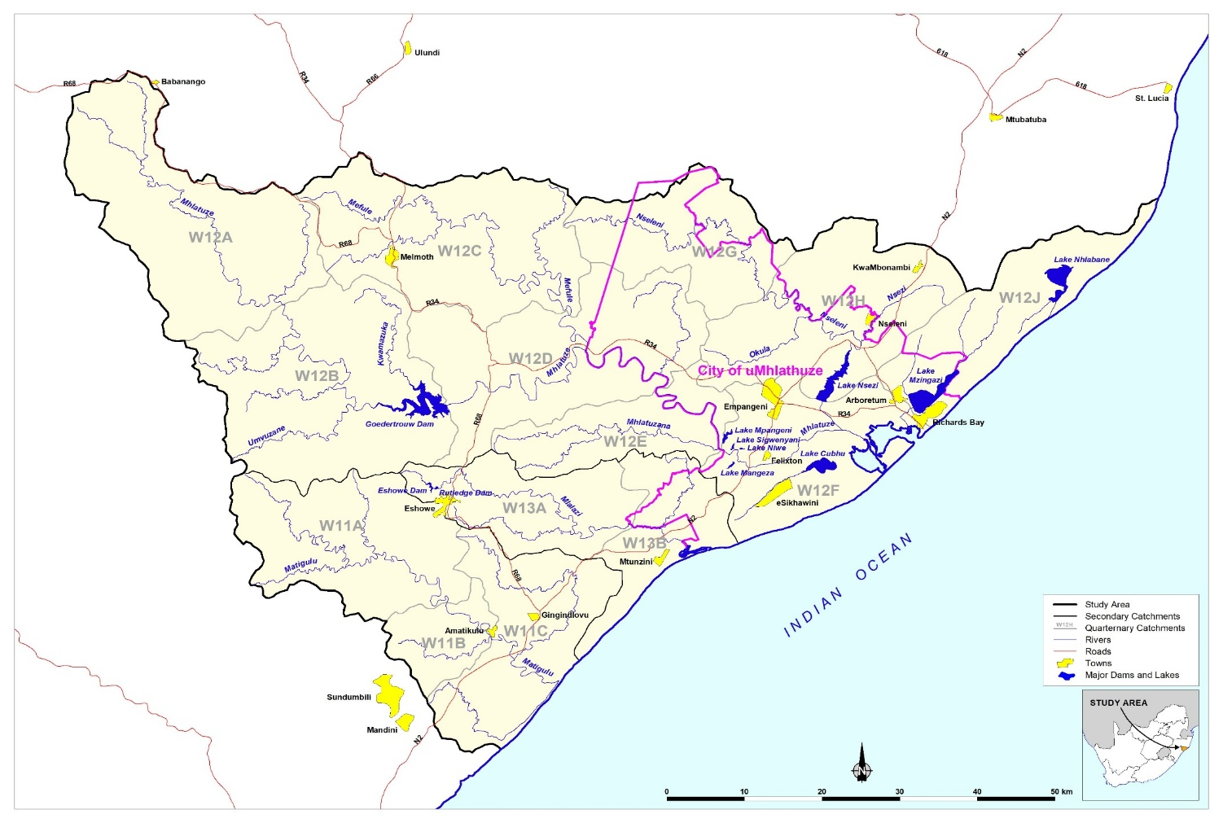
Background to this Assignment
Reconciliation Strategy for the Richards Bay area was developed (2015)
Recommends sequence of management and infrastructural interventions required to maintain acceptable assurances of supply to the users.

Slide 6
Outcomes of previous assignment
Options for reconciling increasing water requirements with the current supply in the Mhlathuze Catchment included:
Water Conservation and Demand Management (WC/WDM)
Removal of Invasive Alien Plants (IAPs) and unlawful afforestation
Infrastructure: Raising Goedertrouw, Transfers: Thukela & Umfolozi, Nseleni Dam
Improvement of System Operation
Seawater Desalination
Reuse of treated effluent
Improved billing of irrigators
Please visit: http://www6.dwa.gov.za/iwrp/projects.aspx for all project related information

Slide 7
Why Continuation of a Strategy? (This Study)
  Water balances need to be continuously monitored / investigated and the strategy regularly updated to remain technically relevant.
  Ensures that intervention planning can be implemented taking into account any changes that may impact on the projected water balance.
  Study Objective: In-depth review, systematically update and improve the water resource reconciliation strategy so that it remains relevant, technically sound, economically viable, socially acceptable and sustainable and thus enabling the implementation of the strategy by the relevant authorities.

Slide 8
Purpose of the Meeting
  Feedback on Strategy interventions
  Overview of study activities since StraSC Meeting 3 (4 Sept 2019)

Slide 9
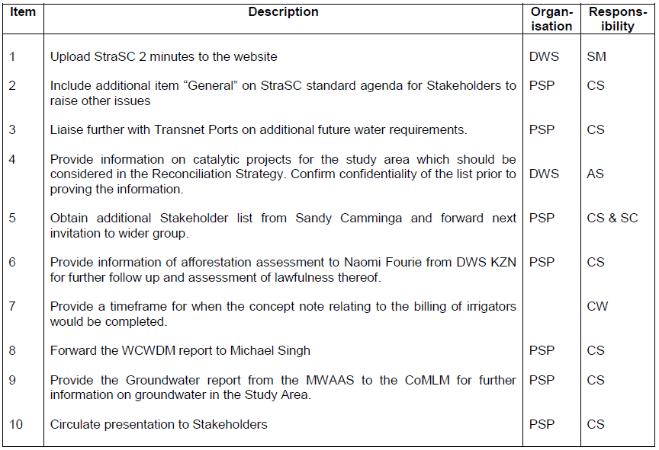

Matters Arising: Action list

Slide 10
Feedback on action item 7.5 of the minutes:
The draft concept note was put on hold as I left WWF to re-join Mondi. However, some progress has been made in that WWF have appointed Pegasus, a consult company who specialise in developing holistic water management solutions, to assist in drafting the concept note and putting the business case together. The WWF/Mondi Partnership still view this as an important project for the region and will continue to work on it.
WWF have also recently appointed a new water stewardship project manager in the Richards Bay region, her name is Patience Makado and I believe she is intending to join your meeting today.

Slide 11
IMPLEMENTATION AND MAINTENANCE OF THE WATER RECONCILIATION STRATEGY FOR RICHARDS BAY AND SURROUNDING TOWNS
Strategy Steering Committee Meeting
(StraSC) 4
Item 7: Status of Strategy (2015) Interventions

Slide 12
Infrastructure
Existing Thukela Transfer | DWS Regional
Thukela Transfer Upgrade | DWS Regional
Mfolozi off Channel Storage | DWS: HO
Land Care (Aliens, Afforestation) | DWS Regional & CMF
Feasibility Study | Mhlathuze Water
WCWDM | CoMLM
Use of Treated Effluent | CoMLM
Billing of Irrigators | DWS Regional & Irrigation Sector
Operational | DWS Regional

Slide 13
IMPLEMENTATION AND MAINTENANCE OF THE WATER RECONCILIATION STRATEGY FOR RICHARDS BAY AND SURROUNDING TOWNS
Strategy Steering Committee Meeting
(StraSC) 4
Item 8: Overview of Study Activities

Slide 14
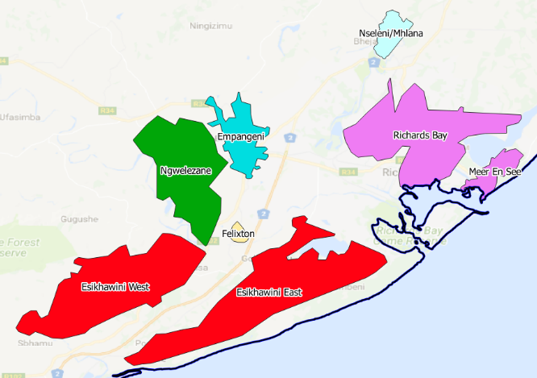
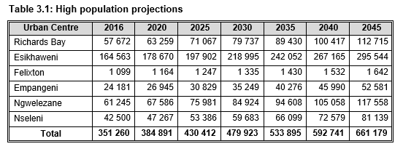
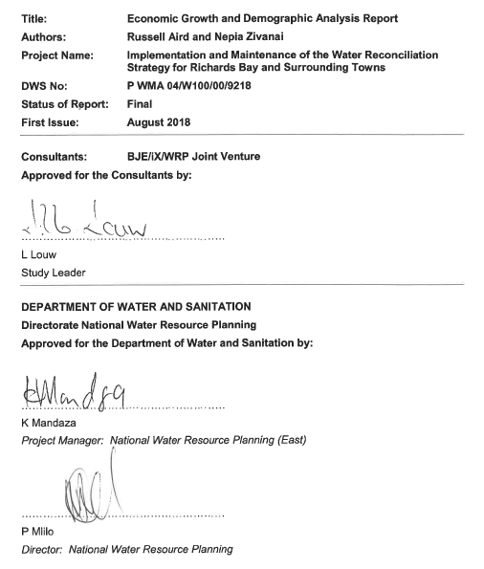
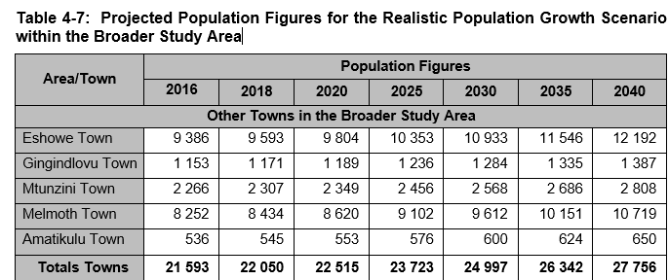
TASK 2: Demographics & Socio-Economics

Slide 15
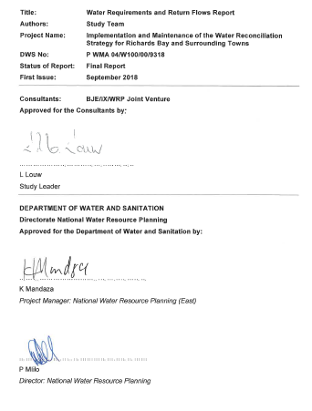
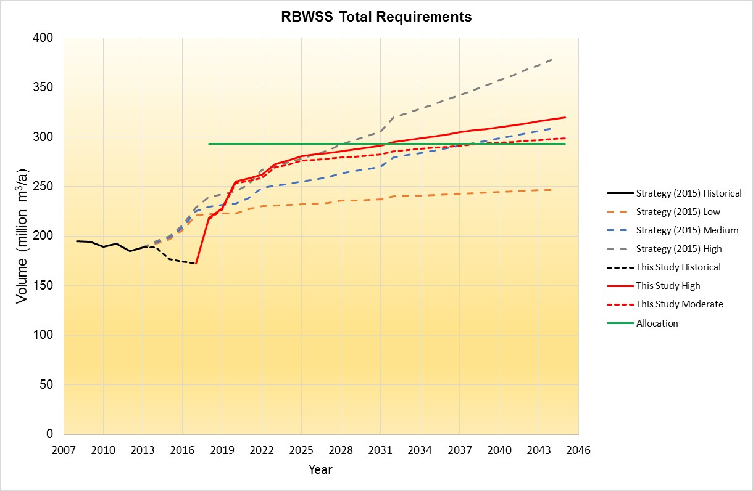
TASK 3: Water Requirements & Return Flows

Slide 16
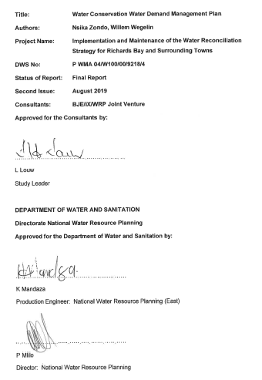
TASK 4: WC/WDM

Slide 17
IMPLEMENTATION AND MAINTENANCE OF THE WATER RECONCILIATION STRATEGY FOR RICHARDS BAY AND SURROUNDING TOWNS
Strategy Steering Committee Meeting
(StraSC 4)
Item 9: Current Progress: Water Resources

Slide 18
Task 7: Water Resources Analyses
Objective: Determine the water resources capability of the system, ie. water available from existing resources as well as potential new resources
Results to feed into final Strategy in the form of water balance plots

Slide 19
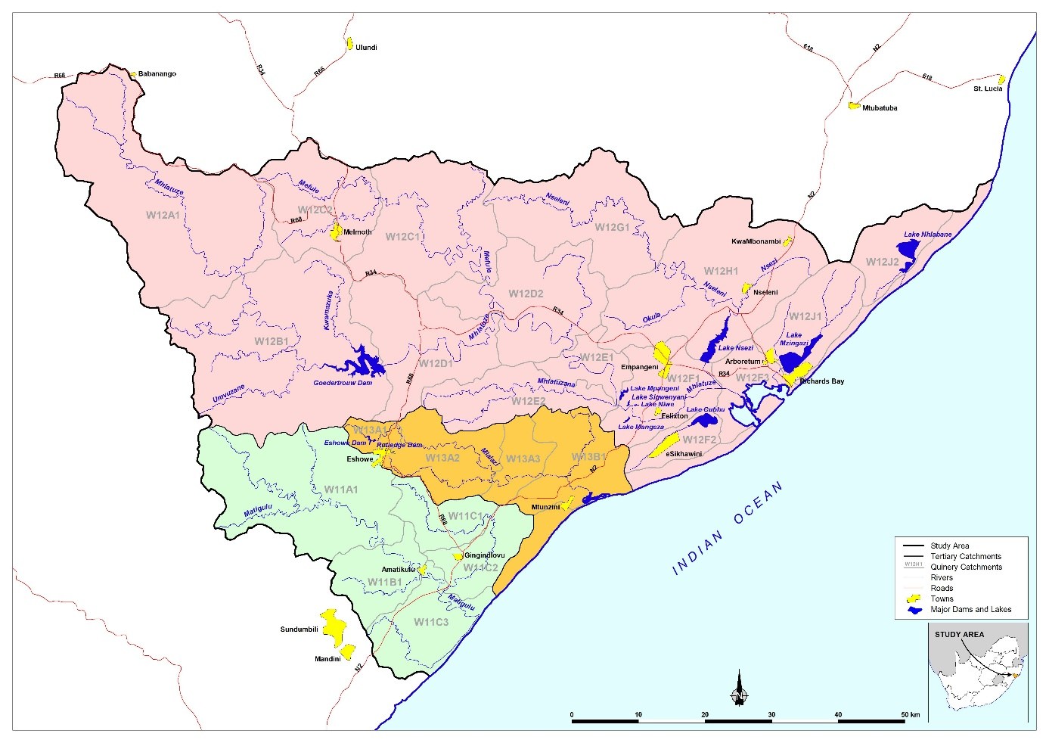
Summary of supporting information
Hydrology
  MWAAS (1920-2003)
  24 sub-catchments

Slide 20
Summary of supporting information
Infrastructure (existing)
  Goedertrouw Dam & Lakes
  Thukela Transfer
  Internal transfers
Infrastructure (future)
  Increased Thukela transfer
  Raising of Goedertrouw
  Dam on Nseleni River (1 MAR: 55 million m³)
  Dam on Mhlathuzana River (0.3 MAR: 7 million m³)
  Umfolozi off channel storage Dam

Slide 22

Water Resources Yield Analyses
Methodology: gather all water demands from their point of abstraction to a central “yield” node
Surplus water, channel abstracted from Mhlathuze weir
Yield

Slide 23
Water Resources Yield Analyses
Historic firm yield: 245 million m³/annum
Long Term Stochastic Yields
Stochastic firm yield at levels of assurance in supply (M m³/annum)
99.5 % | 99.0 % | 98.0 % | 95.0 %
1:200 years | 1:100 years | 1:50 years | 1:20 years
243.3 | 251.6 | 260.0 | 272.3

Slide 24
Water Resources Yield Analyses
Long Term Stochastic Yields: Eshlazi & Rutledge Dams
Raised Goedertrouw (2.8m, 35 million m³): 5.8 million m³ additional yield
Dam on the Nseleni: 12 million m³ additional yield
Dam on Mhlathuzana: < 1 million m³ additional yield, EWR concerns
Off channel Umfolozi: 37 million m³ additional yield
Stochastic firm yield at levels of assurance in supply (Mm³/annum)
99.0 % | 98.0 % | 95.0 %
1:100 years | 1:50 years | 1:20 years
1.58 | 1.77 | 2.0

Slide 25
Water Resources Planning Model Scenario Analyses
Existing System (including current Thukela transfer operating at capacity) is able to supply existing users at their required assurance of supply until 2021. Therefore existing system availability for various user assurances is 248 million m³/a
This increases to 292 million m³/a after the increased capacity of the Thukela transfer comes online. This provides a system balance until year 2039 afterwhich further augmentation will be required
There appears to be an infrastructure capacity constraint for the supply to Esikhaweni via the transfer from the Mhlathuze weir

Slide 26
Simplified water balance
High demand projection additional users
High demand projection existing users
High demand projection existing users incl. WCWDM
Allocation
Irrigation
Volume (million m³/annum)
Industrial
Urban
Years

Slide 27
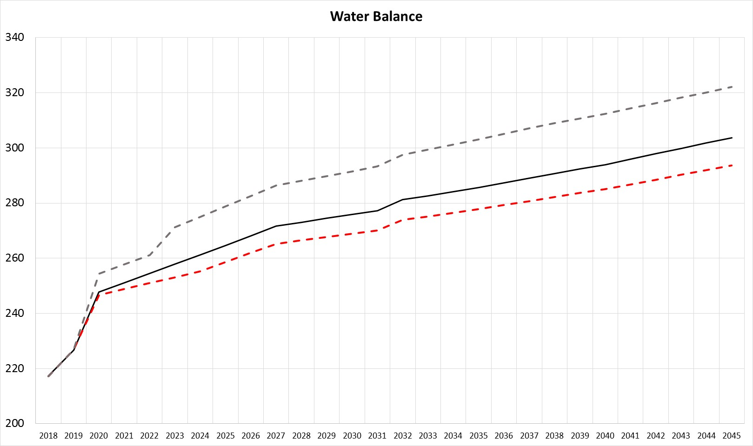
Adjusted scale
High demand projection additional users
High demand projection existing users
High demand projection existing users incl. WCWDM
Volume (million m³/annum)
Years

Slide 28
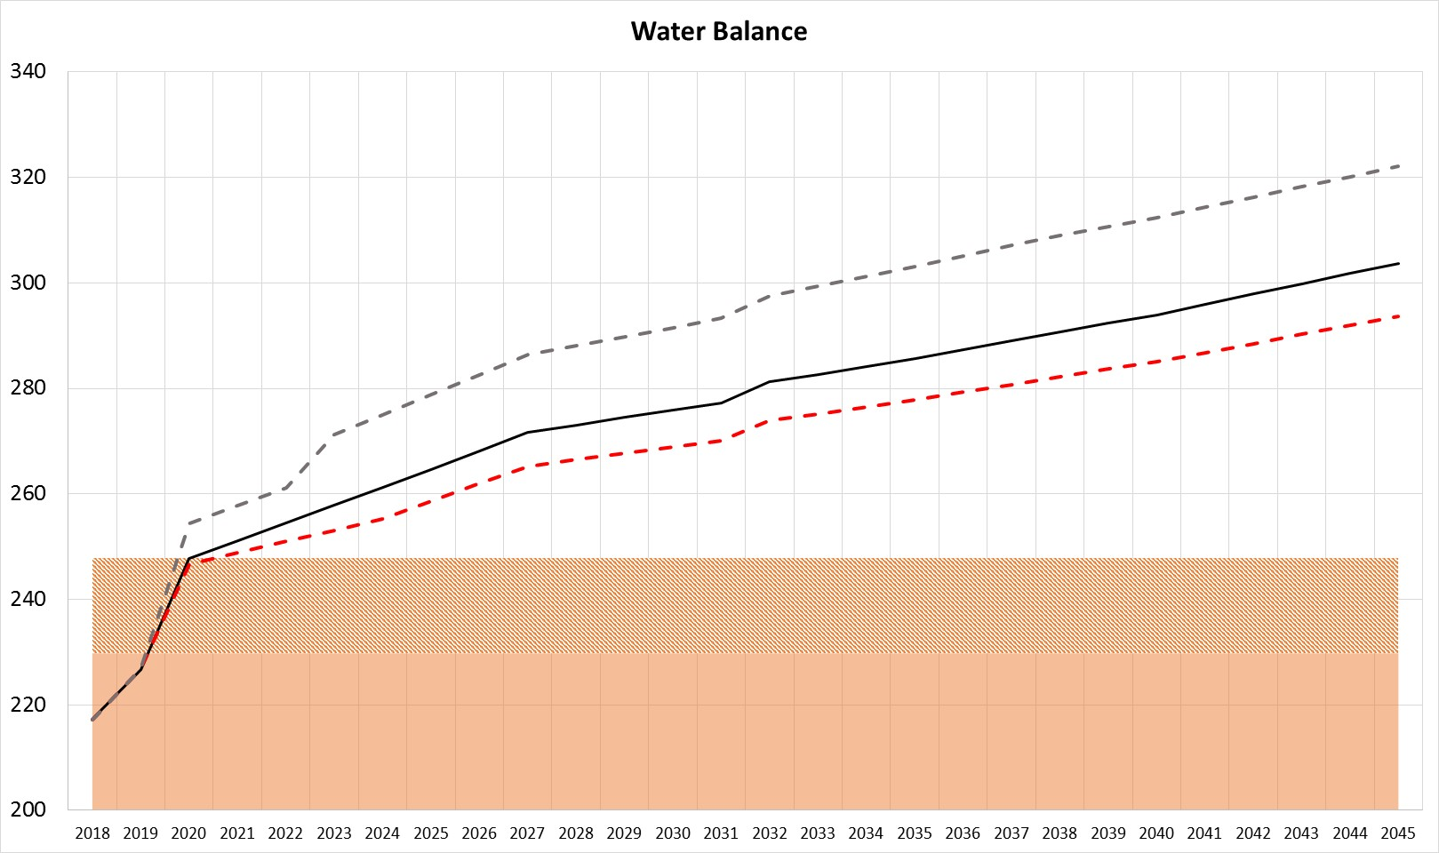
Simplified water balance
High demand projection additional users
High demand projection existing users
High demand projection existing users incl. WCWDM
Volume (million m³/annum)
Including efficient operation
Existing yield: including Thukela Phase 1
Years

Slide 29
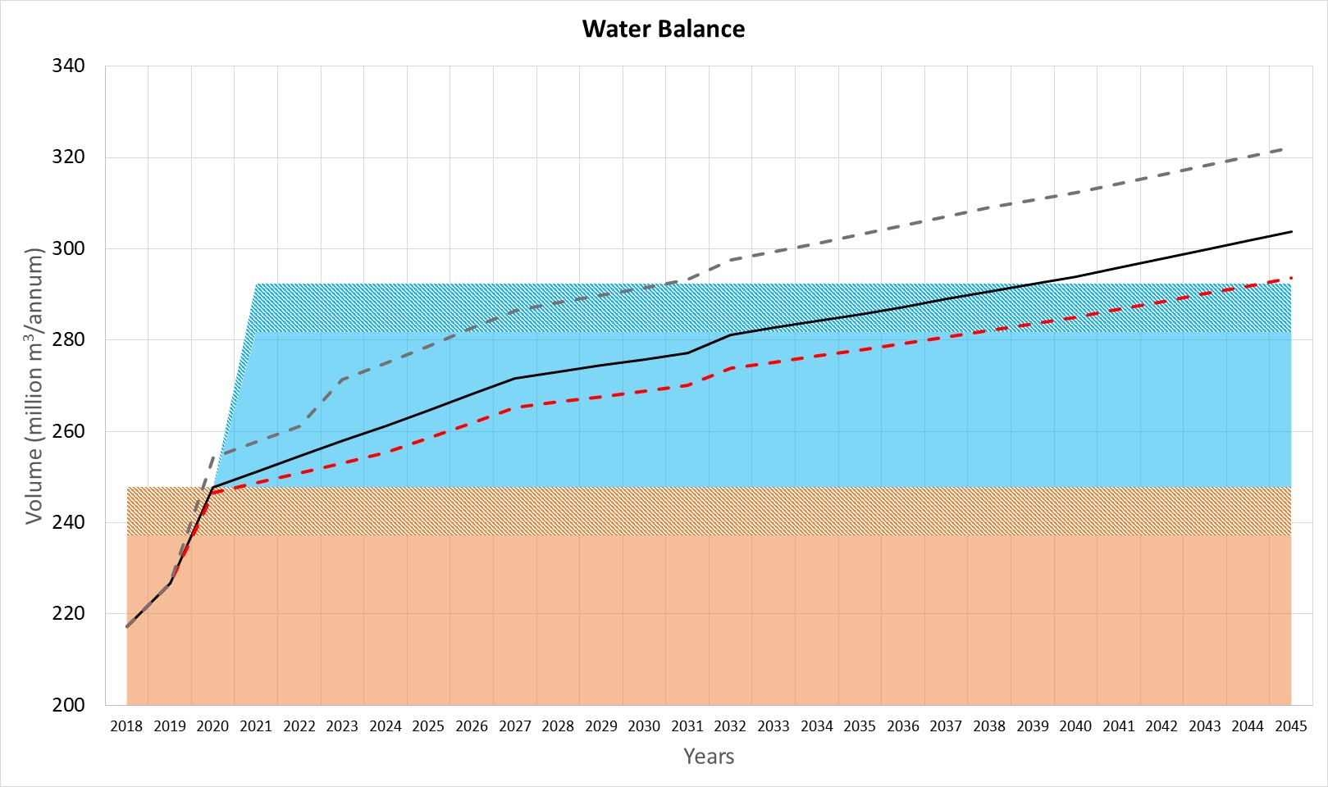
Simplified water balance
High demand projection additional users
High demand projection existing users
High demand projection existing users incl. WCWDM
2039 Year
Requirements > availability
Volume (million m³/annum)
Thukela Phase 2
Including efficient operation
Existing yield: including Thukela Phase 1
Years

Slide 30
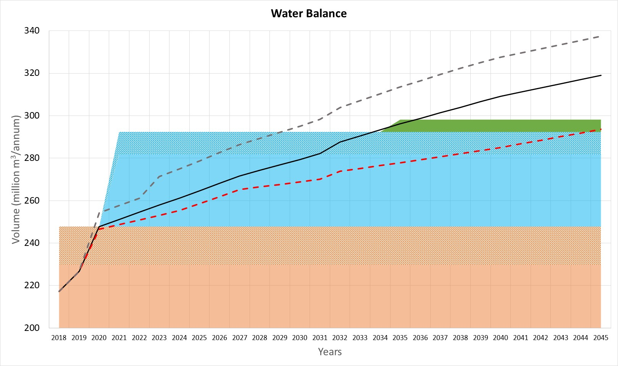
Simplified water balance
High demand projection additional users
High demand projection existing users
High demand projection existing users incl. WCWDM
2034 Year
Requirements > availability
Increased Water Requirements at Phobane WTW
Raise Goedertrouw
Volume (million m³/annum)
Thukela Phase 2
Including efficient operation
Existing yield: including Thukela Phase 1
Years

Slide 31
Water Resources Planning Model Scenario Analyses
Mtunzini is supplied satisfactorily when including the additional supply from CoMLM
Eshowe is supplied satisfactorily when combining its own resources with the transfer from Goedertrouw
Melmoth is not supplied at a satisfactory assurance, even when including boreholes
Gingindlovu is not supplied at a satisfactory assurance

Slide 32
IMPLEMENTATION AND MAINTENANCE OF THE WATER RECONCILIATION STRATEGY FOR RICHARDS BAY AND SURROUNDING TOWNS
Strategy Steering Committee Meeting
(StraSC 4)
Item 10: Discussion and Comments

